Slide 1
Overview of Programming Language

Slide 2
What is a language? - Language is the medium of communication to share ideas, opinion with each other.
What is a programming language? - Programming language is the medium of communication between you (a person) and a computer system.
A programming language is a set of rules that provides a way of telling a computer what operations to perform.
A programming language is a set of rules for communicating an algorithm.
It provides a linguistic framework for describing computations

Slide 3
Why should I learn programming language? - There are some great reasons, for which we should learn code –
For increasing Logical Ability
Coding Teaches us - How to Approach Problem – Solving
Out of the box Thinking – enhances Creativity
Improved Critical-thinking skills
Programming keeps our mind active and busy… for Lifetime
Being Able to Turn an Idea Into an App
Automate Daily Tasks and Save Time

Slide 4
Levels of computer programming languages - There are basically two types of computer programming languages, they are –
Low Level Programming Languages - Low-level languages are designed to operate and handle the entire hardware and instructions set architecture of a computer directly.
e.g., Machine Language and Assembly Language are popular examples of low-level languages.
High Level Programming Languages - These are the machine independent programming languages, which are easy to write, read, edit and understand.
e.g., The languages like Java, .Net (C#), C++, C etc. are the example of high-level languages.

Slide 5
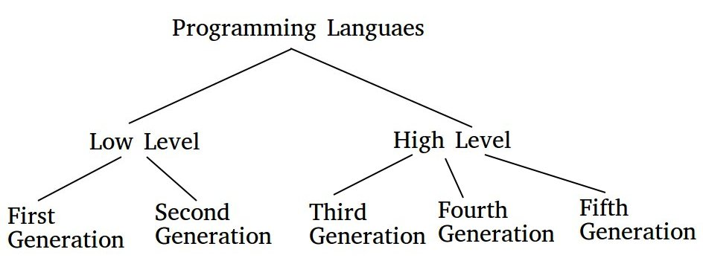
Generations of computer programming languages - There are basically five types of computer programming languages based on generation, they are –
First Generation Language - A first-generation programming language (1GL) is a machine-level programming language. It is a grouping of programming languages that are machine level languages used to program first-generation computers.

Slide 6
Second Generation Language - Second generation languages, or 2GL, are low-level assembly languages that are specific to a particular computer and processor.
Third Generation Language - A third-generation programming language (3GL) is a high-level computer programming language that tends to be more machine-independent and programmer-friendly than the machine code of the first-generation and assembly languages of the second-generation, while having a less specific focus to the fourth and fifth generations.
For example - ALGOL, BASIC, C, COBOL, Fortran and Pascal.
Fourth Generation Language - Fourth-generation language (4GL), are closer to human language than other high-level languages and are accessible to people without formal training as programmers. They allow multiple common operations to be performed with a single programmer-entered command.
For example – Python, Ruby, Perl etc.
Fifth Generation Language - Fifth-generation languages are used mainly in artificial intelligence & research. OPS5 and Mercury are examples of fifth-generation languages, all are built upon Lisp.

Slide 7
Types of computer programming languages – We can classify our programming languages in 4 sections, based on their principal programming paradigms, they are –
Procedural Programming Language - A procedural language is a computer programming language that follows, in order, a set of commands.
Example – BASIC, FORTRAN, C, PASCAL etc.
Object-oriented Programming Language - Object-oriented programming (OOP) is a computer programming model that organizes software design around data, or objects, rather than functions and logic. An object can be defined as a data field that has unique attributes and behavior.
Example – C++, JAVA, C# etc.
Functional Programming Language - Functional programming languages are specially designed to handle symbolic computation and list processing applications. Functional programming is based on mathematical functions.
Example - Lisp, Python, Erlang, Haskell, Clojure, etc.
Scripting Programming Language - Scripting languages are made for specific runtime environments, and they automate some of the code implementation.
Example – JavaScript, VBScript, BASH Script etc.

Slide 8

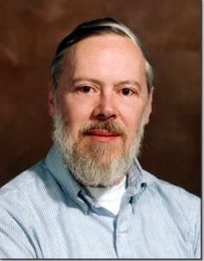
Overview of C Programming Language
C was originally developed in the 1970s, by Dennis Ritchie at AT&T Bell Labs, Inc.
C is a mid level, general–purpose structured procedural oriented programming language. Instructions of C consists of terms that are very closely same to algebraic expressions, consisting of certain English keywords such as if, else, for ,do and while etc.
C contains certain additional features that allows it to be used at a lower level, acting as bridge between machine language and the high level languages.
These allows C to be used for system programming as well as for applications programming.

Slide 9
Basic Structure of C Programming Language
#include<stdio.h>
#include<conio.h>
void main()
{
clrscr();
printf("Hello World\n");
getch();
}
Explanation –
1. #include<stdio.h> - Includes the standard input output library functions. The printf() function is defined in stdio.h .
2. void main() - The main() function is the entry point of every program in c language.
3. printf() - The printf() function is used to print data on the console.

Slide 10
WAP to find the sum of two numbers
#include<stdio.h>
#include<conio.h>
void main()
{
int a,b,c=0;
clrscr();
printf(“Enter the numbers: ”);
scanf(“%d %d”, &a, &b);
c = (a + b);
printf(“Sum is: %d”, c);
getch();
}

Slide 11
A language is a language but there is a difference…
Programming languages are also a language
When it comes to mechanics of the task, learning to speak and use a programming language is in many ways like learning to speak a human language
In both kind of languages we have to learn new vocabulary, syntax and semantics (new words, sentence structure and meaning)
And both kind of language require considerable practice to make perfect

